Slide 1

EECS 370 - Lecture 8
Combinational Logic
Live Poll + Q&A: slido.com #eecs370
Poll and Q&A Link

Slide 2
Announcements

Slide 3
Floating Point Arithmetic
See end of slides for bonus material (not covered in HW or exams)

Slide 4
Why floating point
Have to represent real numbers somehow
Rational numbers
Ok, but can be cumbersome to work with
Fixed point
Do everything in thousandths (or millionths, etc.)
Not always easy to pick the right units
Different scaling factors for different stages of computation
Scientific notation: this is good!
Exponential notation allows HUGE dynamic range
Constant (approximately) relative precision across the whole range

Slide 5
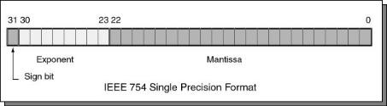
IEEE Floating point format (single precision)
Sign bit: (0 is positive, 1 is negative)
Significand: (also called the mantissa; stores the 23 most significant bits after the decimal point)
Exponent: used biased base 127 encoding
Add 127 to the value of the exponent to encode:
-127 → 00000000 1 → 10000000
-126 → 00000001 2 → 10000001
… …
0 → 01111111 128 → 11111111
How do you represent zero ? Special convention:
Exponent: -127 (all zeroes ), Significand 0 (all zeroes), Sign + or -
Some other exception cases (e.g. NaN) we won't cover

Slide 6
Floating Point Representation
10.625 ₁₀
1010.101 ₂
Step 1: convert from decimal to binary
1st bit after "binary" point represents 0.5 (i.e. 2⁻¹)
2nd bit represents 0.25 (i.e. 2⁻²)
etc.

Slide 7
Floating Point Representation
10.625 ₁₀
1010.101 ₂
1.010101 × 2 ³
Step 2: normalize number by shifting binary point until you get 1.XXX * 2^{Y}

Slide 8
Floating Point Representation
10.625 ₁₀
1010.101 ₂
1.010101 × 2 ³
+/-
Exponent (3)
Significand (1010101)
This must be a 1!
So don’t store it.
1 bit
8 bits
23 bits
Step 3: store relevant numbers in proper location (ignoring initial 1 of significand)

Slide 9
Floating Point Representation
10.625 ₁₀
1010.101 ₂
1.010101 × 2 ³
+/-
Exponent (3)
Significand (1010101)
This must be a 1!
So don’t store it.
1 bit
8 bits
23 bits
10.625₁₀ = 0 10000010 01010100000000000000000

Slide 10
Class Problem
Poll
What is the value of the following IEEE 754 floating point encoded number?
1
10000101
01011001000000000000000
1 = -
10000101 = 133 – 127 -> exponent 6
01011001 = mantissa
-1.01011001 x 2^6
-1010110.01
-(2^6+2^4+2^2+2^1+2^-2)
-(64+16+4+2+1/4)
-86.25
10
Notes:
1 = -
10000101 = 133 – 127 -> exponent 6
01011001 = mantissa
-1.01011001 x 2^6
-1010110.01
-(2^6+2^4+2^2+2^1+2^-2)
-(64+16+4+2+1/4)
-86.25

Slide 11
What matters to a CS person?
When you are adding small numbers to big numbers, the result may not change
E.g. 1.00 x 10³ + 1.00 x 10¹ = 1000+1=1.00x10³
This can be a real problem when writing scientific code.
For the above example, imagine you did that addition a million times
You’d still have 1000 when the answer should be 1,001,000
So you need to be aware of the issue.
This is why most people use “double” instead of “float”
The problem can still exist, it’s just less likely.

Slide 12
More precision and range
We've described IEEE-754 binary32 floating point format, i.e. “single precision” (“float” in C/C++)
24 bits precision; equivalent to about 7 decimal digits
3.4 * 10³⁸ maximum value
Good enough for most but not all calculations
IEEE-754 also defines larger binary64 format, “double precision” (“double” in C/C++)
53 bits precision, equivalent to about 16 decimal digits
1.8 * 10³⁰⁸ maximum value
Most accurate physical values currently known only to about 47 bits precision, about 14 decimal digits

Slide 13
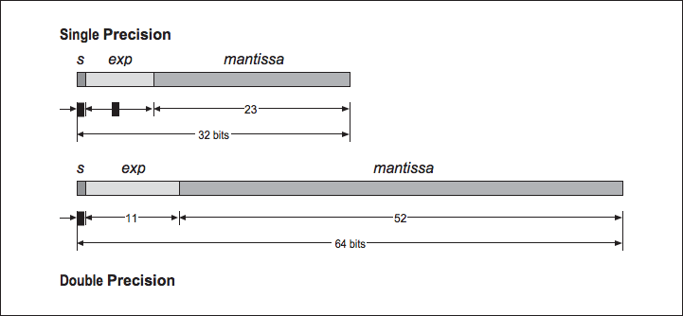
Single (“float”) precision
8

Slide 14
Next few lectures: Digital Logic
Lectures 1-7:
LC2K and ARMv8/LEGv8 ISAs
Converting C to Assembly
Function Calls
Linking
Today:
Floating Point
Combinational Logic
Next lecture:
Sequential Logic

Slide 15
Up Until Now…
We’ve covered high-level C code to an executable
Compilation
Assembly
Linking
Loading
Now, we’ll talk about the hardware that runs this code
First step: the basics of digital logic

Slide 16
Next 3 Lectures
Combinational Logic:
Basics of electronics; logic gates, muxes, decoders
Sequential Logic
Clocks, latches and flip-flops
State Machines
Building a simple processor

Slide 17
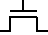

Transistors
At the heart of digital logic is the transistor
Electrical engineers draw it like this
The physics is complicated, but at the end of the day, all it is a really small and really fast electric switch
High voltage here makes transistor act like a wire*
Low voltage here makes transistor act like an open switch*
We use 1 to represent HIGH voltage, 0 to represent LOW voltage
1
0
*Yeah, yeah, circuits people. It's a lot more complicated than that. This abstraction is fine for 370.

Slide 18
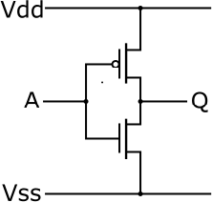
Basic gate: Inverter
Schematic symbol (CS/EE)
CS abstraction - logic function
I
O
Truth Table
I
O
0
1
1
0
We won't focus on this part in 370. Take 270 and 312 to learn more

Slide 19
Basic gates: AND and OR
AND
OR
Truth Table
A
B
Y
A
B
0
0
1
1
0
1
0
1
0
0
0
1
Y
Truth Table
A
B
Y
0
0
1
1
0
1
0
1
0
1
1
1
A
B
Y

Slide 20
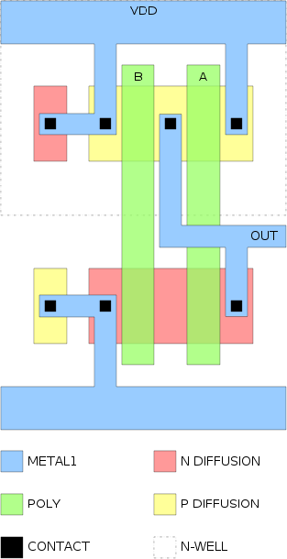
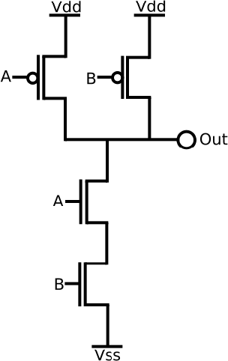
Basic gate: NAND
Layout schematic
Transistor-level schematic
Truth Table
A
B
Y
0
0
1
1
0
1
0
1
1
1
1
0
A
B
Y
Take 427 to learn more (sooooo many rectangles in that class)
Bubble is symbolic for "invert", so this is equivalent to negating an AND gate

Slide 21
Basic gate: XOR (eXclusive OR)
Truth Table
A
B
Y
0
0
1
1
0
1
0
1
0
1
1
0
A
B
Y
Poll: How do we fill in the truth table for XOR? XNOR?
XNOR Gate
A
B
Y
Live Poll + Q&A: slido.com #eecs370

Slide 22
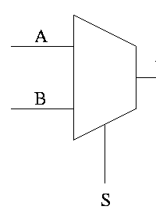
Building Complexity: Selecting
We want to design a circuit that can select between two inputs (multiplexer or mux)
Let’s do a one-bit version
Draw a truth table
Symbol
O
A
B
S
O
0
0
0
0
0
0
1
1
0
1
0
1
Poll: How do we fill in the truth table for this?
O = S ? B : A
1
1
1
1
0
0
1
1
0
1
0
1
Live Poll + Q&A: slido.com #eecs370

Slide 23
Building Complexity: Selecting
We want to design a circuit that can select between two inputs (multiplexor or mux)
Let’s do a one-bit version
Draw a truth table
Symbol
O
A
B
S
O
0
0
0
0
0
0
1
1
0
1
0
1
0
0
0
1
Circuit
Muxes are universal! A 2^{N} entry truth table can be implemented by passing each ouput value into an input of a 2^{N}–to-1 mux
Is A if S is 0
Is 0 if S is 1
A
O = S ? B : A
1
1
1
1
0
0
1
1
0
1
0
1
1
0
1
1
S
C
Is A if S is 0
Is B if S is 1
B
Is 0 if S is 0
Is B if S is 1

Slide 24
Building Complexity: Addition
We want to design a circuit that performs binary addition
Let’s start by adding two bits
Design a circuit that takes two bits (A and B) as input
Generates a sum and carry bit (S and C)
Make a truth table
Design a circuit
1 0 0 1 1
+ 0 0 1 1 0
A
B
C
S

Slide 25
Building Complexity: Addition
We want to design a circuit that performs binary addition
Let’s start by adding two bits
Design a circuit that takes two bits (A and B) as input
Generates a sum and carry bit (S and C)
Make a truth table
Design a circuit
0 1 1 0
1 0 0 1 1
+ 0 0 1 1 0
1 1 0 0 1
A
B
C
S
A
0
0
1
1
0
1
0
1
0
0
0
1
0
1
1
0
S
B
C

Slide 26
Building Complexity: Addition
0 1 1 0
1 0 0 1 1
+ 0 0 1 1 0
Now we can add two bits, but how do we deal with carry bits?
This is a full adder
We have to design a circuit that can add three bits
Inputs: A, B, Cin
Outputs: S, Cout
Design a truth table
Circuit
This is a full adder
1 1 0 0 1
Cin
A
B
Cout
S
0
0
0
0
0
0
1
1
0
1
0
1
0
0
0
1
0
1
1
0
A B C_{in}
1
1
1
1
0
0
1
1
0
1
0
1
0
1
1
1
1
0
0
1
C_{out}
S

Slide 27
8-bit Ripple Carry Adder
If we invert B's bits and set C to 1, we also have a subtractor! Why?
A₇ B₇
A₆ B₆
A₅ B₅
A₄ B₄
A₃ B₃
A₂ B₂
A₁ B₁
C
A₀ B₀
Full
adder
Full
adder
Full
adder
Full
adder
Full
adder
Full
adder
Full
adder
Full
adder
Carry
S₇
S₆
S₅
S₄
S₃
S₂
S₁
S₀
This will be very slow for 32 or 64 bit adds, but is sufficient for our needs

Slide 28
Building Complexity: Decoding
Another common device is a decoder
Input: N-bit binary number
Output: 2^{N} bits, exactly one of which will be high
Allows us to index into things (like a register file)
Decoder
A₀
Out₀
A₁
Poll: What will be the output for 101?
Out₁
Out₂
Out₃
Live Poll + Q&A: slido.com #eecs370

Slide 29
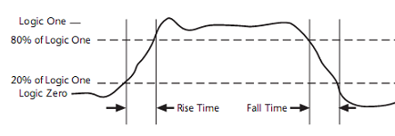
Propagation delay in combinational gates
Gate outputs do not change exactly when inputs do.
Transmission time over wires (~speed of light)
Saturation time to make transistor gate switch
⇒ Every combinatorial circuit has a propagation delay (time between input and output stabilization)
I
Vdd
I
O
gnd
Vdd
O
gnd

Slide 30
Timing in Combinational Circuits
Delay of gate G2
d_{G2}
d_{G3}
d_{G2}
d_{G3}
MUX
A
S
A
G1
X
S
C
B
B
G2
G3
Y
X
Y
C
time
What is the input/output delay (or simply, delay) of the MUX?

Slide 31
What is the delay of this Circuit?
Each oval represents one gate, the type does not matter
Poll : What is the delay?
A
B
3
5
2
F
C
D
1
6
E
We only care about the longest path, or critical path
Live Poll + Q&A: slido.com #eecs370

Slide 32
Exercise
Use the blocks we have learned about so far (full adder, NOR, mux) to build this circuit
Input A, 32 bits
Input B, 32 bits
Input S, 1 bit
Output, 32 bits
When S is low, the output is A+B, when S is high, the output is NOR(a,b)
Hint: you can express multi-bit gates like this:
32
32
32
Full
Adder
Circuit
32
32
32

Slide 33
Exercise
This is a basic ALU (Arithmetic Logic Unit)
It is the heart of a computer processor!
32
A
Full
Adder
Circuit
0
32
output
1
B
32
S

Slide 34

Next Time
Logic circuits that "remember"
Aka "sequential logic"
Lingering questions / feedback? I'll include an anonymous form at the end of every lecture: https://bit.ly/3oXr4Ah
Live Poll + Q&A: slido.com #eecs370

Slide 35
BONUS Floating Point Slides

Slide 36
Bonus slides – this material is not testable
Not testable
This material is here for those folks that may care.
You may find it useful when considering the gap between representations
But the material isn’t directly testable.
It is interesting if you are into that kind of thing.
It can be useful if you are going to do scientific programming for a living.
So it is provided as a reference, but isn’t part of the class (we may cover a bit of it in lecture if we have time)

Slide 37
Floating point multiplication
Not testable
Add exponents (don’t forget to account for the bias of 127)
Multiply significands (don’t forget the implicit 1 bits)
Renormalize if necessary
Compute sign bit (simple exclusive-or)

Slide 38
Floating point multiply
Not testable
10.625 ₁₀ = 1010.101₂
0 10000010 01010100000000000000000
+
×
10 ₁₀ = 1010₂
0 10000010 01000000000000000000000
-127
1 0 1 0 1 0 1
× 1 0 1
0 10000101 10101001000000000000000
1 0 1 0 1 0 1
1 0 1 0 1 0 1 0 0
1101010.01₂
= 106.25₁₀
1 1 0 1 0 1 0 0 1
EECS 370: Introduction to Computer Organization
38

Slide 39
Floating point addition
Not testable
More complicated than floating point multiplication!
If exponents are unequal, must shift the significand of the smaller number to the right to align the corresponding place values
Once numbers are aligned, simple addition (could be subtraction, if one of the numbers is negative)
Renormalize (which could be messy if the numbers had opposite signs; for example, consider addition of +1.5000 and – 1.4999)
Added complication: rounding to the correct number of bits to store could denormalize the number, and require one more step

Slide 40
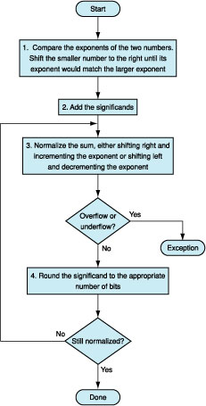
Floating point Addition
Not testable
Shift smaller exponent right to match larger.
Add significands
Normalize and update exponent
Check for “out of range”
EECS 370: Introduction to Computer Organization
40

Slide 41
Class Problem
Not testable
Show how to add the following 2 numbers using IEEE
floating point addition: 101.125 + 13.75
EECS 370: Introduction to Computer Organization
41

Slide 42
Class Problem
Not testable
101.125
0
10000101
10010100100000000000000
13.75
0
10000010
10111000000000000000000
Shift mantissa by difference in exponent
Shift by 6-3 = 3
00110111000000000000000
Sum Significands
Note: When shifting to the right, the first shift should put the implicit 1, then 0’s
1 1 0 0 1 0 1 0 0 1
+ 0 0 0 1 1 0 1 1 1 0
1 1 1 0 0 1 0 1 1 1
0
10000101
1100101110000000000000
Sum didn’t overflow, so no re-normalization needed
= 114.875

Slide 43
Class Problem
Not testable
Show how to add the following 2 numbers using IEEE
floating point addition: 117.125 + 13.75
EECS 370: Introduction to Computer Organization
43

Slide 44
Class Problem
Not testable
117.125
0
10000101
11010100100000000000000
13.75
0
10000010
10111000000000000000000
Shift mantissa by difference in exponent
Shift by 6-3 = 3
00110111000000000000000
Sum Significands
Note: When shifting to the right, the first shift should put the implicit 1, then 0’s
1 1 1 0 1 0 1 0 0 1
+ 0 0 0 1 1 0 1 1 1 0
1 0 0 0 0 0 1 0 1 1 1
0
10000110
0000010111000000000000
Sum overflows, re-normalize by adding one to exponent and shifting mantissa by one
= 130.875

